Slide 1

Bài 5: Exception Handling, Concurrency
Giảng viên: Nguyễn Thành Trung
Email: Trungnt9@topica.edu.vn
‹#›

Slide 2

Exception handing in java
Exception?
Exception is abnormal condition that arised at run time
Event that disrupts the normal flow of the program
It is object which thrown at runtime
Exception Handing
Exception Handing is merchanism to handle runtime errors
Normal flow of the application can be maintained
Exception handling done with the exception object
‹#›

Slide 3
Types of errors
There are three categories of error:
Syntax Error – arise because the rule of the language have not been followed. They are detected by the compiler
Runtime Error – occur while the program is running if the environment detect an operation that is impossible carry out
Logic Error – occur when a program doesn’t perform the way is was intended to
Java are three types of exceptions:
Checked exception – are checked at compile-time
Unchecked Exception – are not checked at compile time rather they are checked at runtime
Error
‹#›

Slide 4
Types of errors
Checked exception
Part of the method signature
Compile type checking
Requires programmer to handle the exception or declare the method as thrown exception
E.g. FileNotFoundException
Checked exception
No need to declare the exception in method signature
No compile time checking
Usually indicate programming error
E.g. NullPointerException
‹#›

Slide 5
Types of errors
Error
Indicate error in the underlying JVM
Error are external to the application
Application does not usually have to deal with these class of Exception
E.g. OutOfMemoryError
When to throw exceptions
Exceptions indicate a broken contract
Precondition
Postcondition
Your method encounters an abnormal condition that it can’t handle
If your method is unable to fulfill its contract, throw either a checked or unchecked exception
‹#›

Slide 6
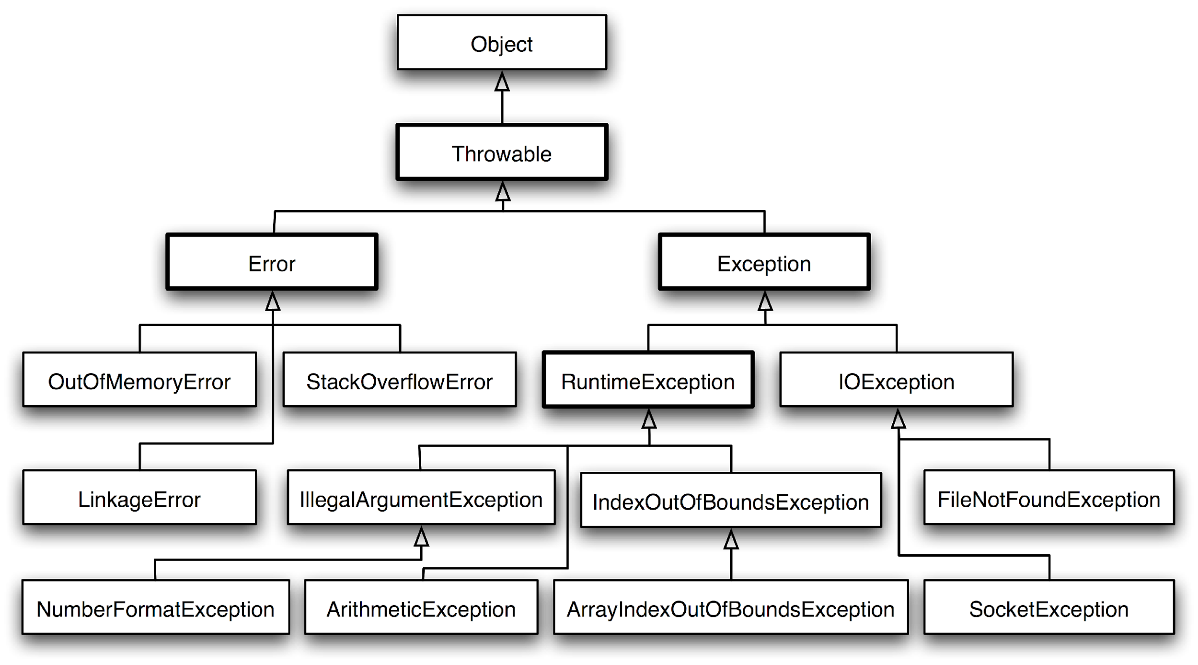
Exception Type Hierachy
‹#›

Slide 7
Exception Lifecycle
After an exception object is created, it is handed off to the runtime system (thrown).
The runtime system attempts to find a handler for the exception by backtracking the ordered list of methods that had been called.
This is known as the call stack.
If a handler is found, the exception is caught.
It is handled, or possibly re-thrown.
If the handler is not found (the runtime backtracks all the way to the main() method), the exception stack trace is printed to the standard error channel (stderr) and the application aborts execution.
For example:
java ExceptionDemo 100 0 Exception in thread "main" java.lang.ArithmeticException: / by zero
at ExceptionDemo.divideInts(ExceptionDemo.java:21)
at ExceptionDemo.divideStrings(ExceptionDemo.java:17)
at ExceptionDemo.divideArray(ExceptionDemo.java:10)
at ExceptionDemo.main(ExceptionDemo.java:4)
‹#›

Slide 8
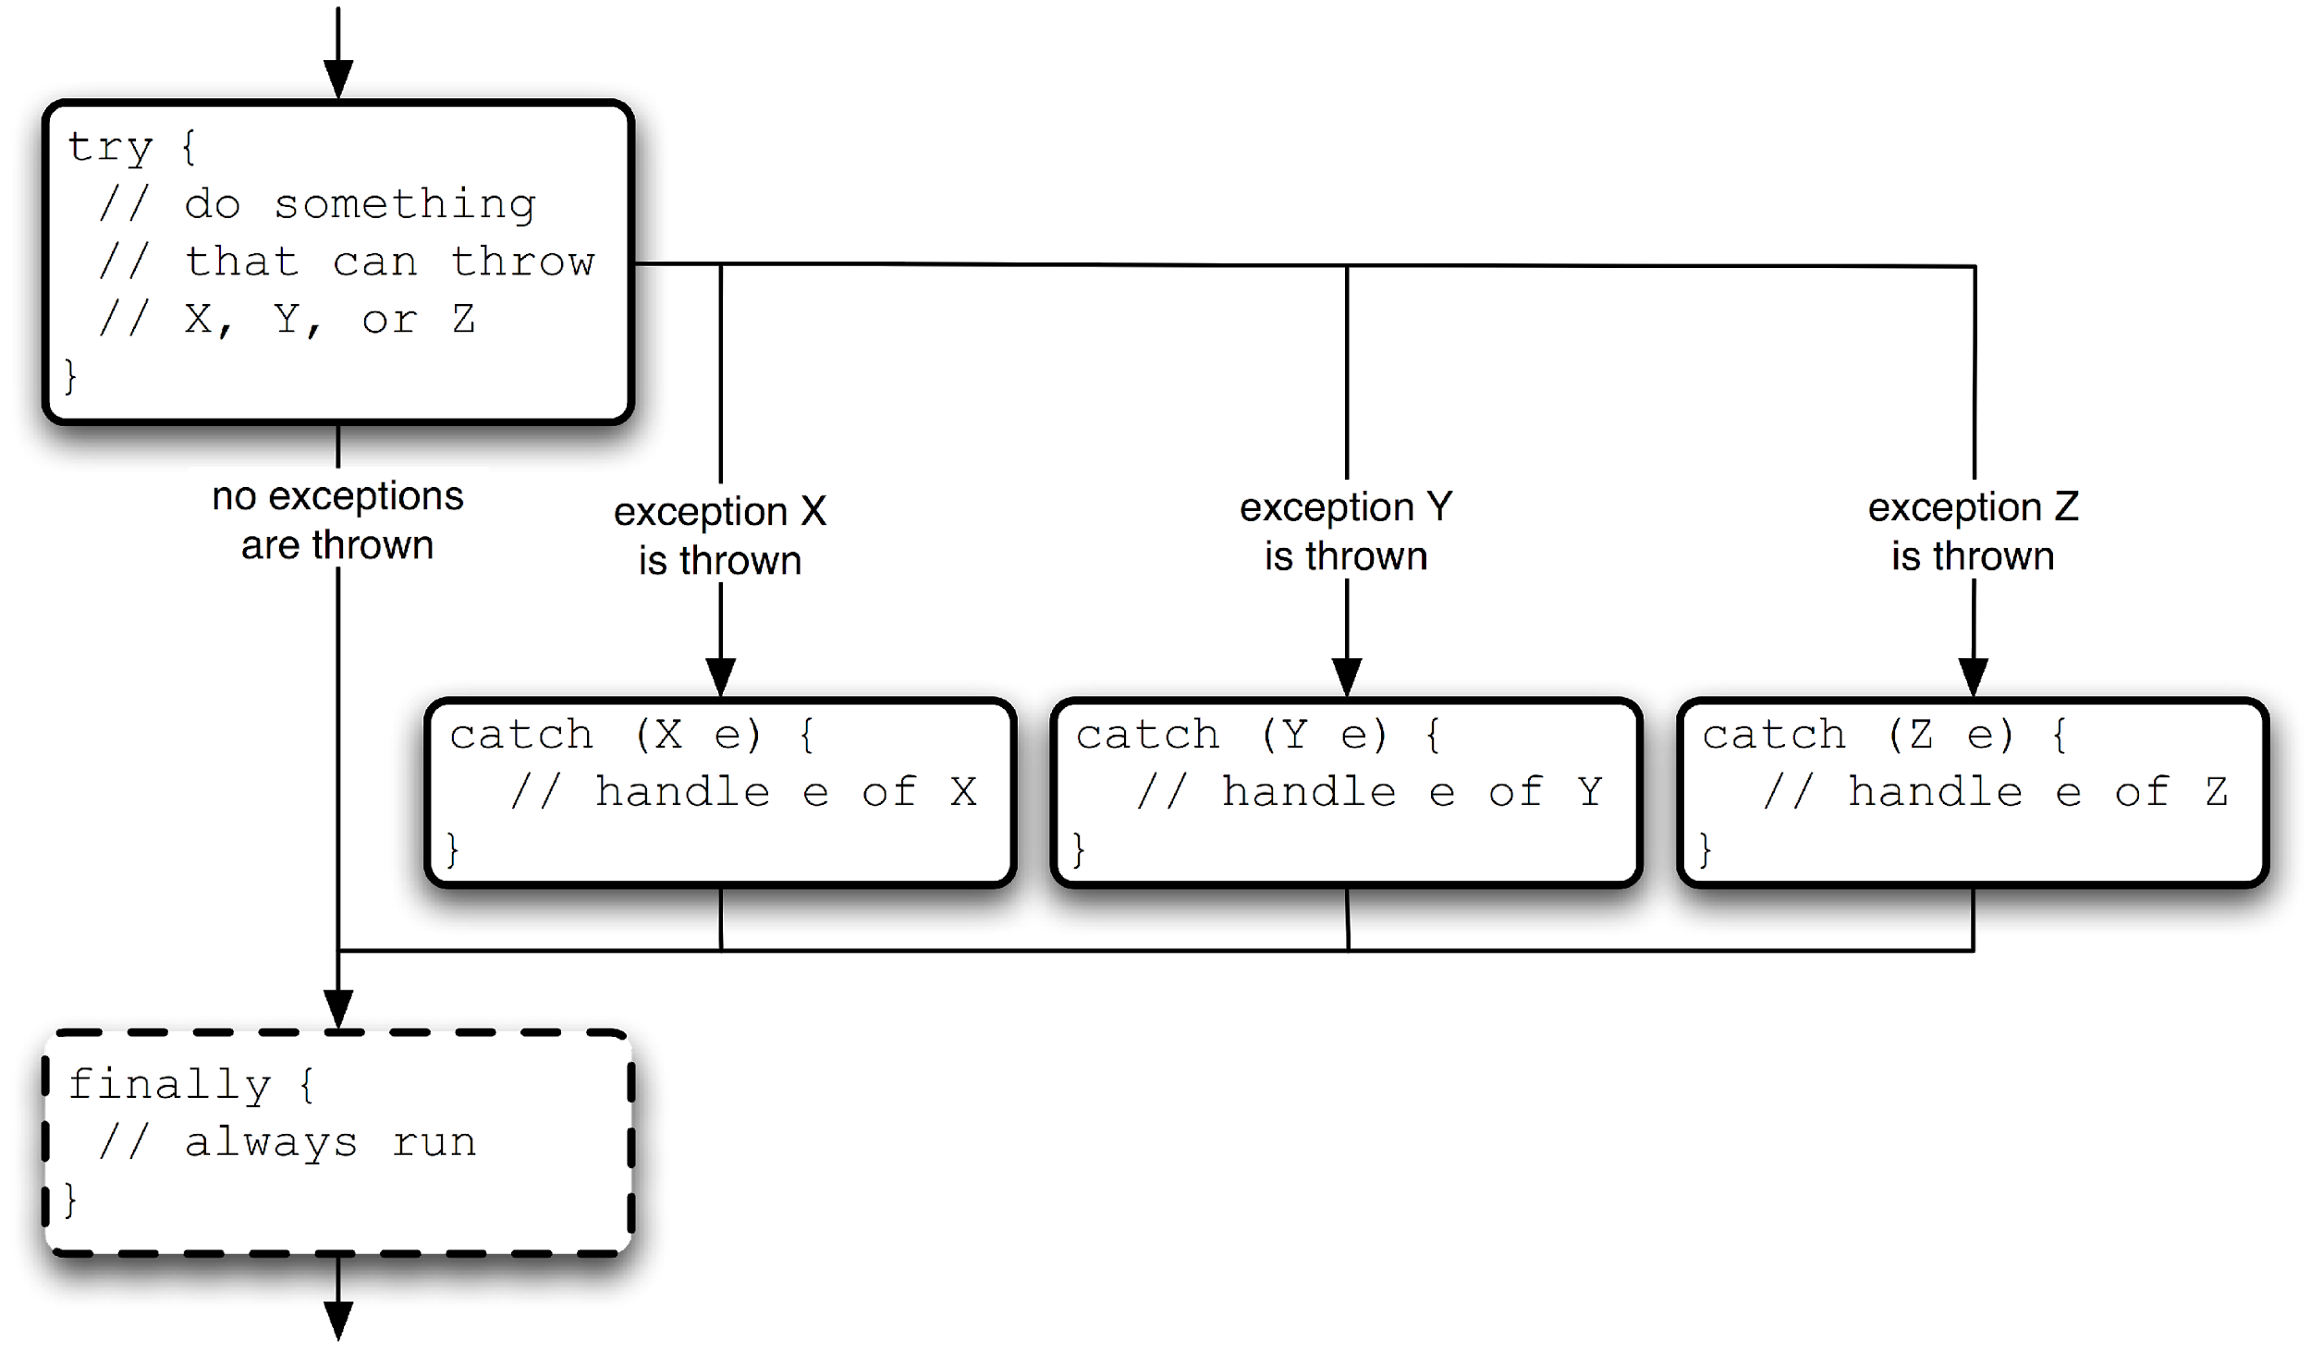
Handling Exceptions
‹#›

Slide 9
Throwing Exception
A method that generates an unhandled exception is said to throw an exception. That can happen because:
It generates an exception to signal an exceptional condition, or
A method it calls throws an exception
Declare that your method throws the exception using the throws clause.
This is required only for checked exceptions.
Recommended: Document (in JavaDoc) that the method @throws the exception and under what circumstances.
To generate an exceptional condition:
Create an exception of the appropriate type. Use predefined exception types if possible, or create your own type if appropriate.
Set the error message on the exception, if applicable.
Execute a throw statement, providing the created exception as an argument.
‹#›

Slide 10
Creating an Exception Class
If you wish to define your own exception:
Pick a self-describing *Exception class name.
Decide if the exception should be checked or unchecked.
Checked extends Exception
Unchecked extends RuntimeException
Define constructor(s) that call into super’s constructor(s), taking message and/or cause parameters.
Consider adding custom fields, accessors, and mutators to allow programmatic introspection of a thrown exception, rather than requiring code to parse an error message.
‹#›

Slide 11
Nesting Exceptions
A Throwable object can nest another Throwable object as its cause.
To make APIs independent of the actual implementation, many methods throw generic exceptions. For example:
Implementation exception: SQLException
API exception: DataAccessException
API exception nests implementation exception
To get the original implementation exception, do apiException.getCause()
‹#›

Slide 12

Exception
‹#›

Slide 13
Concurrency
- The Java platform is designed from the ground up to support concurrent programming, with basic concurrency support in the Java programming language and the Java class libraries.
- Since version 5.0, the Java platform has also included high-level concurrency APIs
‹#›

Slide 14
Processes and Threads
Processes
A process has a self-contained execution environment
A process generally has a complete, private set of basic run-time resources; in particular, each process has its own memory space.
Most operating systems support Inter Process Communication (IPC) resources, such as pipes and sockets. IPC is used not just for communication between processes on the same system
Threads
Threads are sometimes called lightweight processes. Both processes and threads provide an execution environment, but creating a new thread requires fewer resources than creating a new process
Threads exist within a process — every process has at least one
Threads share the process's resources, including memory and open files. This makes for efficient, but potentially problematic, communication.
‹#›

Slide 15
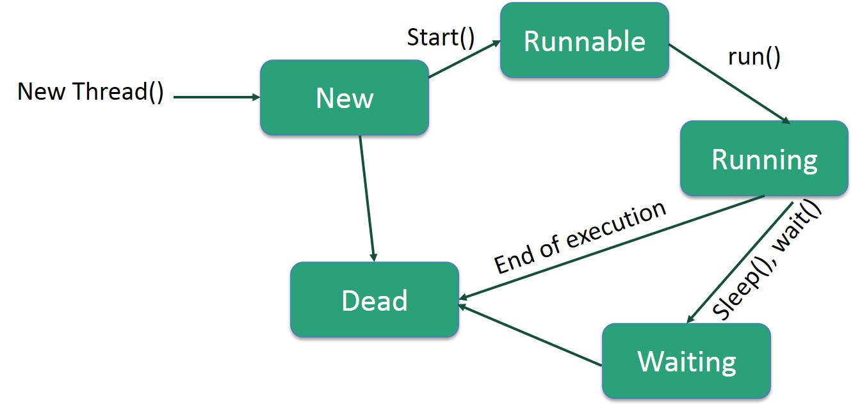
Life Cycle of a Thread
‹#›

Slide 16
Defining and Starting a Thread
Provide a Runnable object. The Runnable interface defines a single method, run, meant to contain the code executed in the thread. The Runnable object is passed to the Thread constructor, as in the HelloRunnable example:
public class HelloRunnable implements Runnable {
public void run() {
System.out.println("Hello from a thread!");
}
public static void main(String args[]) {
(new Thread(new HelloRunnable())).start();
}
}
Subclass Thread. The Thread class itself implements Runnable, though its run method does nothing. An application can subclass Thread, providing its own implementation of run, as in the HelloThread example:
public class HelloThread extends Thread {
public void run() {
System.out.println("Hello from a thread!");
}
public static void main(String args[]) {
(new HelloThread()).start();
}
}
‹#›

Slide 17
Thread
Sleep: Thread.sleep causes the current thread to suspend execution for a specified period
Interrupts is an indication to a thread that it should stop what it is doing and do something else. It's up to the programmer to decide exactly how a thread responds to an interrupt, but it is very common for the thread to terminate
A thread sends an interrupt by invoking interrupt on the Thread object for the thread to be interrupted. For the interrupt mechanism to work correctly, the interrupted thread must support its own interruption
Join: The join method allows one thread to wait for the completion of another. If t is a Thread object whose thread is currently executing:
t.join();
‹#›

Slide 18
High Level Concurrency Objects
The high-level concurrency features introduced with version 5.0 of the Java platform. Most of these features are implemented in the new java.util.concurrent packages. There are also new concurrent data structures in the Java Collections Framework.
Lock objects support locking idioms that simplify many concurrent applications.
Executors define a high-level API for launching and managing threads. Executor implementations provided by java.util.concurrent provide thread pool management suitable for large-scale applications.
Concurrent collections make it easier to manage large collections of data, and can greatly reduce the need for synchronization.
Atomic variables have features that minimize synchronization and help avoid memory consistency errors.
ThreadLocalRandom (in JDK 7) provides efficient generation of pseudorandom numbers from multiple threads.
‹#›

Slide 19

‹#›

